Slide 1

emergenCity
Md Touhiduzzaman
Md Nafeez Fahad
Mia Mohammad Imran
Sabbir Alam

Slide 2
Overview
Problem Statement
Motivation
Solution
User-end: App & Sensors
City Officials’ Web Portal
Future Predictions
High Level Overview
Impl.: App
Impl.: Web-Portal
Impl.: Backend & DB
Impl.: Cloud Architecture
Impacts: Social & Business Values
Conclusion

Slide 3
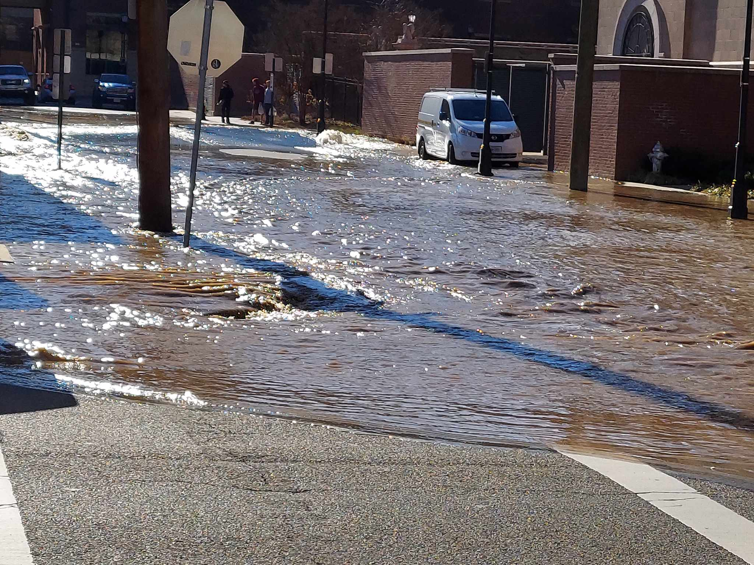
Motivation & Problem Statement
Smart Cities: Challenge 5: Urban Insight - Real-Time Emergency Infrastructure Visualization
User sensor data real-time visualization for City officials?
Real-time Data Integration & Visualization
Push & alert emergency situations?
Interface for City Officials
Water line burst out & Flooding in Main St & Jefferson on Jan-21?
Social Interactions about Emergency Situations
User sensors to Existing emergency service Integration?
Integration with Existing Emergency System
Notes:
Thought about issues in interactions among multiple citizens and city officials based on real time data and emergency situations
A few questions motivating our work can be put like these –
Mutliple sensors at user end, like smoke detectors, air-quality-sensor, temperature & humidity sensors, etc., but rarely any seen solution for city officials to see those data securely

Slide 4

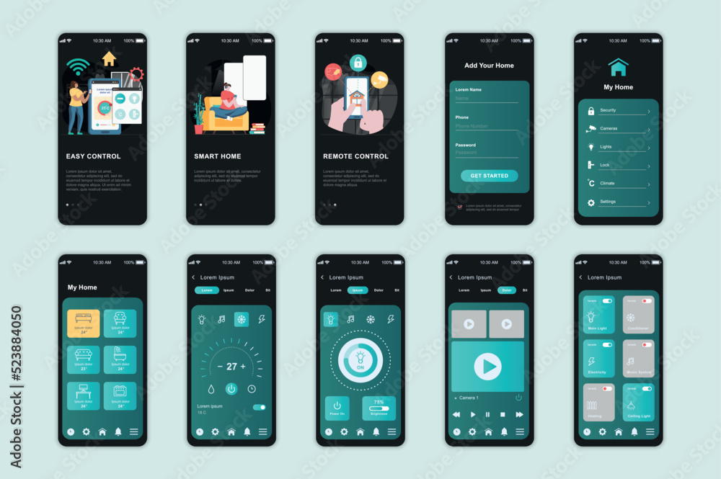


Solution: User-end
Sensors
Smoke detector
AQI Sensors
Pollen in air Sensor
Temperature & Humidity
…
[Horizontally Scalable Sensor Integration]
Mobile App
Show sensor data to user
Call Emergency Services based on Sensor data
Receive PUSH Alerts from City Officials
Social Interaction about Emergency Situations

Slide 5
Solution: Web Portal for City Officials
See Historical Data of a Region
See Predictions for a Future Period
Broadcast Emergency PUSH Alerts to Citizens
Announce Events for Trainings on Emergency Situations
& so on …

Slide 6
Solution: Occurrence Predictions
Prediction On Time Series Data
Example: Spatio-temporal Fire Risk Prediction
Residential/Commercial Fire risk assessment based on historical data
Include time-variant risk factors in addition to spatial features
Use a machine learning model to assess fire risk more effectively from combination of spatial and temporal data.
Singh Walia, B., Hu, Q., Chen, J., Chen, F., Lee, J., Kuo, N., Narang, P., Batts, J., Arnold, G. and Madaio, M., 2018, July. A dynamic pipeline for spatio-temporal fire risk prediction. In Proceedings of the 24th ACM SIGKDD International Conference on Knowledge Discovery & Data Mining (pp. 764-773).

Slide 7




Solution: High Level Overview
User-end
MySQL DB
Sensor-1
ML Prediction System
Mobile App
Sensor-2
REST API
.
.
.
REST API
Back-end
(Starlette REST
API Server)
Sensor-n
PUSH (FCM &/or SMS) Alert

Slide 8
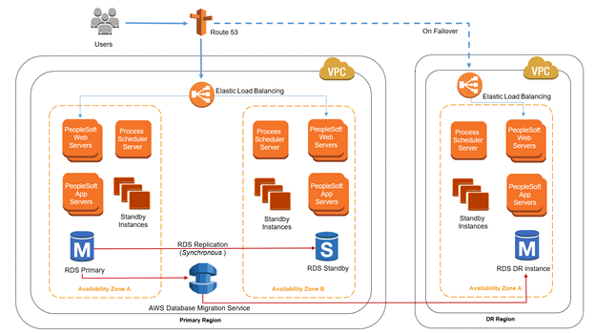
Solution: AWS Cloud Architecture – Backend & Prediction System

Slide 9
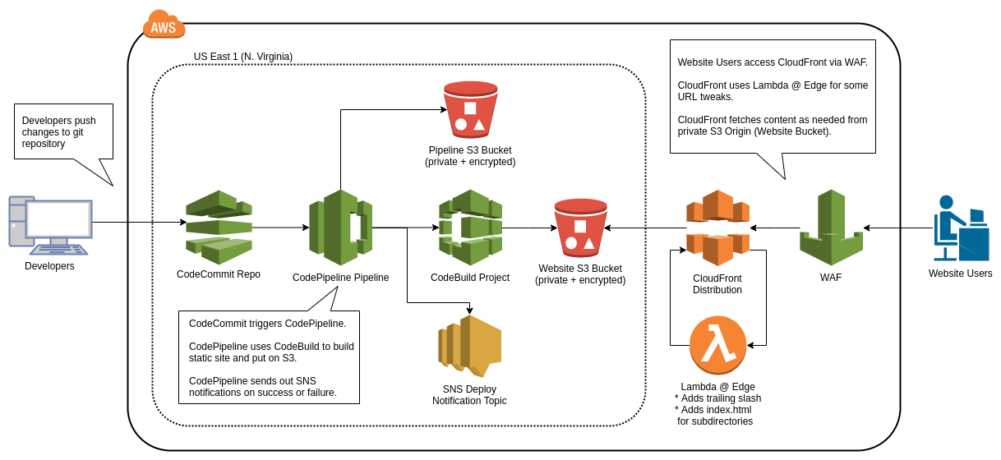
Solution: AWS Cloud Architecture - Frontend

Slide 10
Impacts : Social & Entrepreneurial Scopes

Slide 11

Thank You!
Questions?

Slide 12


Slide 13
